Slide 1
Carnegie Mellon
Computer Systems Organization
https://nyu-cso.github.io
Jinyang Li

Slide 2
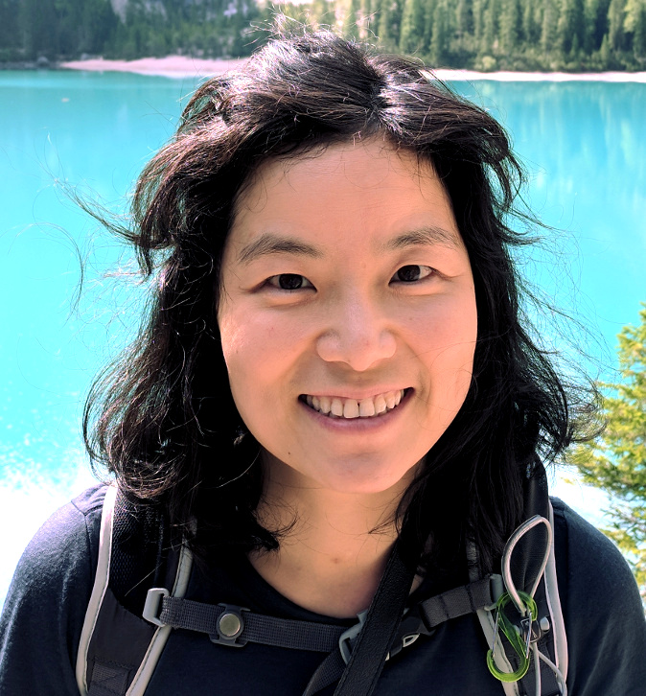
Carnegie Mellon
Course staff
Lecturer: Prof. Jinyang Li
Zoom recitation instructor:
Shraddha Iyer (M.S. student)
In-person recitation instructor:
Shantanu Dahiya (M.S. student)

Slide 3

Course Goal
Beyond learning how to program
Learn the gritty internals of how a computer really works
How does the ring really work?

Slide 4
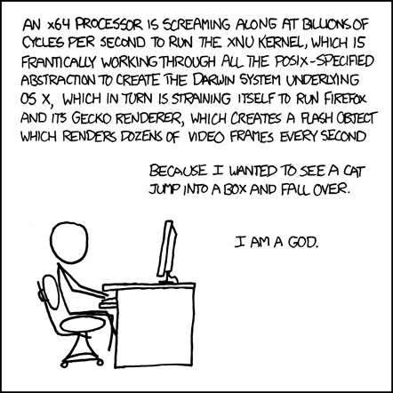
Goal: learn how computers really work
Covered
by CSO
To be covered
by OS (202)

Slide 5

Components of a computer

Slide 6
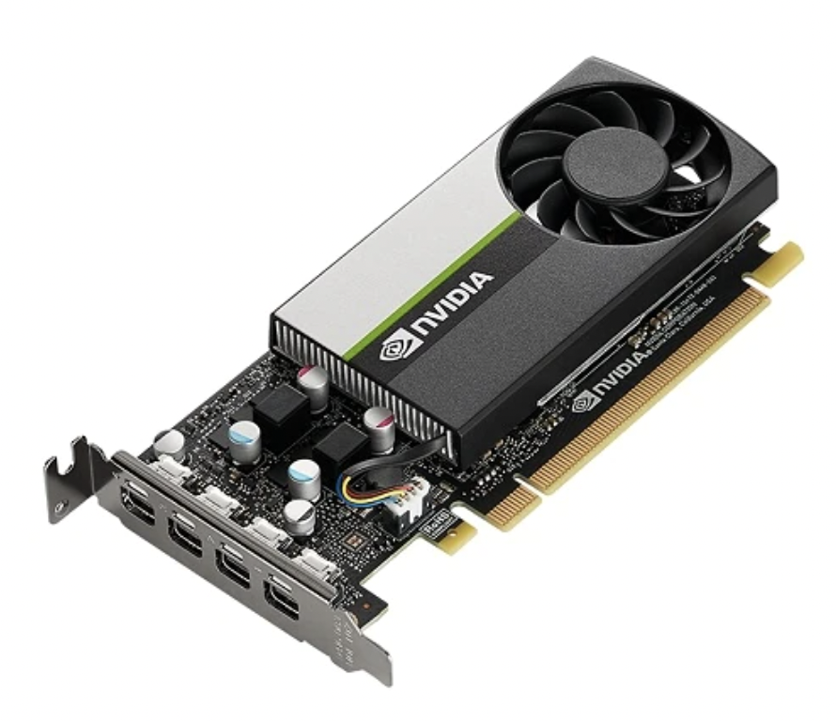
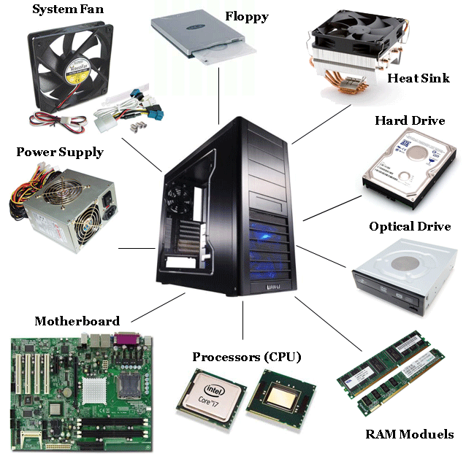
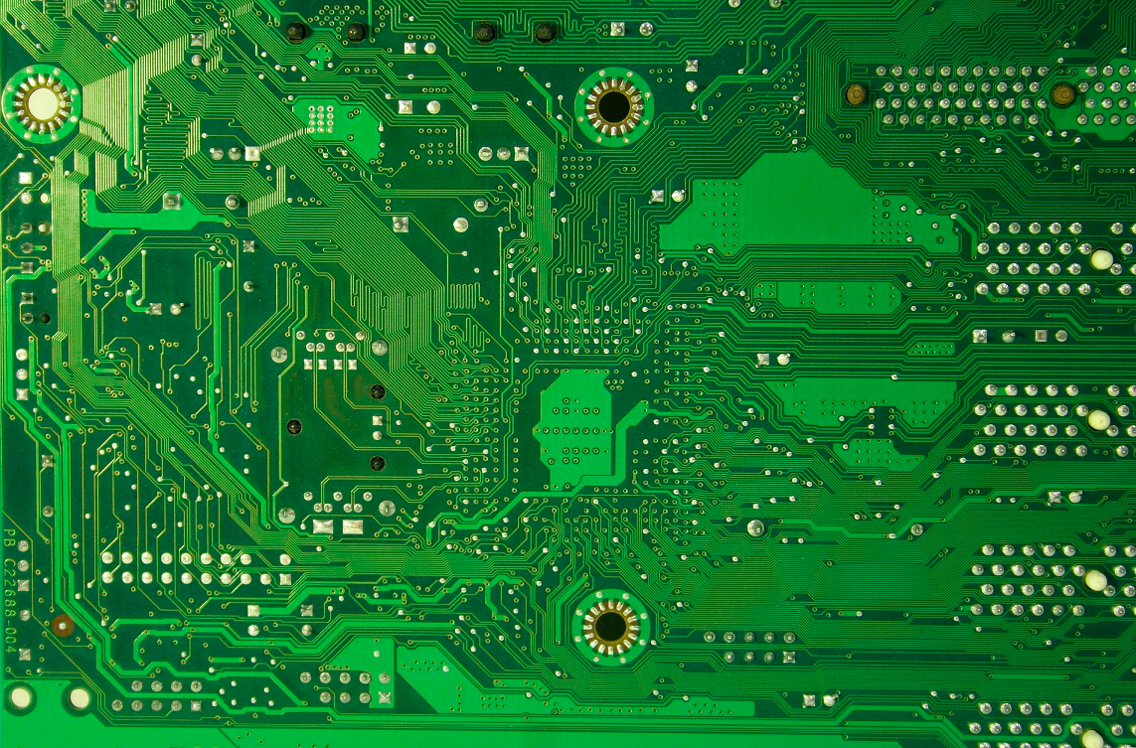
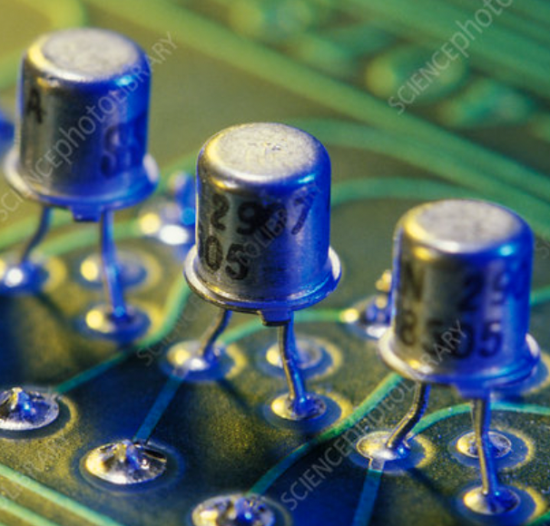
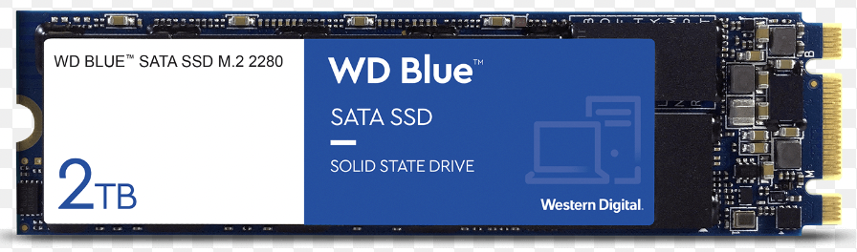

Components of a computer: hardware
GPU
SSD
Printed
Circuits
Transistors
Memory

Slide 7


Components of a computer: hardware + software
Printed Circuit

Slide 8
Layered Organization
Software
Hardware

Slide 9
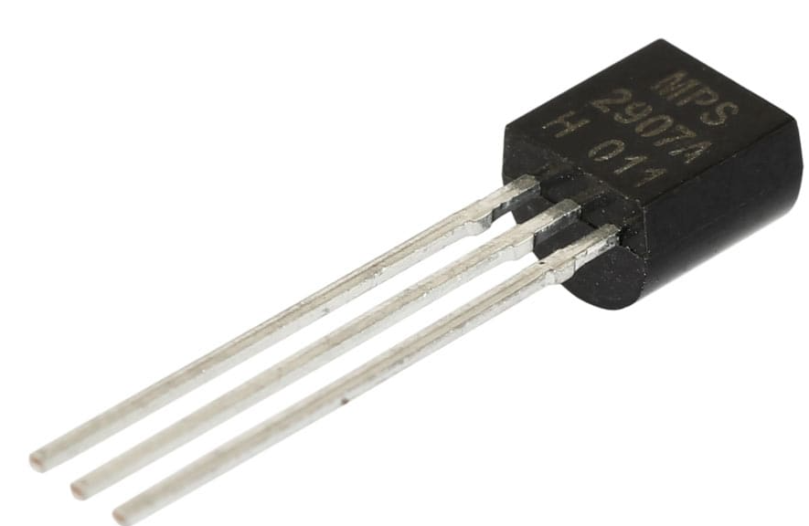
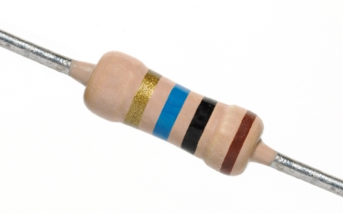

Layered Organization
Software
Hardware
Transistors
Diodes
Resistors

Slide 10
Layered Organization
Software
Hardware
Logical Circuits,
Flip-Flops, Gates
Transistors
Diodes
Resistors

Slide 11
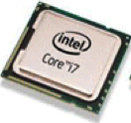
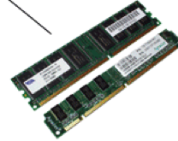
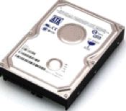
Layered Organization
Software
Hardware
CPU, Memory, Disk
Logical Circuits,
Flip-Flops, Gates
Transistors
Diodes
Resistors

Slide 12
Layered Organization
Software
Hardware
CPU
Memory
I/O
Logical Circuits, Flip-Flops, Gates, …
Transistors, Diodes, Resistors, …

Slide 13







Layered Organization
System Software
(OS, compiler, VM…)
Software
Hardware
CPU
Memory
I/O
Logical Circuits, Flip-Flops, Gates, …
Transistors, Diodes, Resistors, …

Slide 14






Layered Organization
User Applications
System Software
(OS, compiler, VM…)
Software
Hardware
CPU
Memory
I/O
Logical Circuits, Flip-Flops, Gates, …
Transistors, Diodes, Resistors, …

Slide 15

Layered Organization
Users
User Applications
System Software
(OS, compiler, VM…)
Software
Hardware
CPU
Memory
I/O
Logical Circuits, Flip-Flops, Gates, …
Transistors, Diodes, Resistors, …

Slide 16
Layered Organization
User Applications
Apps
System Software
Operating System
Software
Hardware
CPU
Memory
I/O
Logical Circuits, Flip-Flops, Gates, …
Transistors, Diodes, Resistors, …

Slide 17
Abstraction
User Applications
Apps
System Software
Operating System
Software
Hardware
CPU
Memory
I/O
Abstract Interface
Logical Circuits, Flip-Flops, Gates, …
Transistors, Diodes, Resistors, …

Slide 18
Scope of this class
User Applications
Apps
System Software
Operating System
Software
Hardware
CPU
Memory
I/O
Abstract Interface
Logical Circuits, Flip-Flops, Gates, …
Transistors, Diodes, Resistors, …

Slide 19
Scope of this class
How do applications run on a computer?
Hardware/software interface
How do CPU/memory work?
overview of computer architecture

Slide 20
Schedule
https://nyu-cso.github.io
C Programming
overview
bit, byte and int
float point
[C] basics, bitwise operator, control flow
[C] scopes rules, pointers, arrays
[C] structs, mallocs
[C] large program (linked list)

Slide 21
Schedule
https://nyu-cso.github.io
C Programming
overview
bit, byte and int
float point
[C] basics, bitwise operator, control flow
[C] scopes rules, pointers, arrays
[C] structs, mallocs
[C] large program (linked list)
Machine Prog: ISA, Compile, movq
Machine Prog: Control Code (condition, jump instruction)
Machine Prog: Array allocation and access
Machine Prog: Procedure calls
Machine Prog: Structure, Memory Layout
Machine Prog: Buffer Overflow
Assembly (X86)

Slide 22
Schedule
https://nyu-cso.github.io
C Programming
overview
bit, byte and int
float point
[C] basics, bitwise operator, control flow
[C] scopes rules, pointers, arrays
[C] structs, mallocs
[C] large program (linked list)
Machine Prog: ISA, Compile, movq
Machine Prog: Control Code (condition, jump instruction)
Machine Prog: Array allocation and access
Machine Prog: Procedure calls
Machine Prog: Structure, Memory Layout
Machine Prog: Buffer Overflow
Code optimizations
Dynamic Memory Allocation
Dynamic Memory Allocation continued
Assembly (X86)
Dynamic Memory
Allocation

Slide 23
Schedule
https://nyu-cso.github.io
overview
bit, byte and int
float point
[C] basics, bitwise operator, control flow
[C] scopes rules, pointers, arrays
[C] structs, mallocs
[C] large program (linked list)
Machine Prog: ISA, Compile, movq
Machine Prog: Control Code (condition, jump instruction)
Machine Prog: Array allocation and access
Machine Prog: Procedure calls
Machine Prog: Structure, Memory Layout
Machine Prog: Buffer Overflow
Code optimizations
Dynamic Memory Allocation
Dynamic Memory Allocation continued
Logic Design
Logic Design continued
Sequential implementation
Pipelined implementation
C Programming
Assembly (X86)
Dynamic Memory
Allocation
Architecture

Slide 24
Schedule
https://nyu-cso.github.io
C Programming
overview
bit, byte and int
float point
[C] basics, bitwise operator, control flow
[C] scopes rules, pointers, arrays
[C] structs, mallocs
[C] large program (linked list)
Machine Prog: ISA, Compile, movq
Machine Prog: Control Code (condition, jump instruction)
Machine Prog: Array allocation and access
Machine Prog: Procedure calls
Machine Prog: Structure, Memory Layout
Machine Prog: Buffer Overflow
Code optimizations
Virtual memory: Address Spaces/ Translation, Goal
Virtual memory: Page table/physcial to virtual
Process
Dynamic Memory Allocation I: malloc, free
Dynamic Memory Allocation II: design allocator
Dynamic Memory Allocation III: futher optimization
Memory, cache
Memory, cache
Assembly (X86)
Dynamic Memory
Allocation
Architecture
Memory & Cache

Slide 25
Course logistics
Lectures (in-person): T/Th 9:30-10:45am
Recitation(in-person or zoom): M 8-9:15am
Website: https://nyu-cso.github.io
Syllabus
Reading preparation
lecture/recitation slides
Lab instructions
Forum: Campuswire
Q&A
NYU Brightspace
Gradescope
Lab submission, weekly assessments
Zoom links, Zoom recordings
Use Campuswire instead of Brightspace for Q&A.

Slide 26
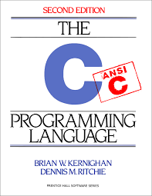
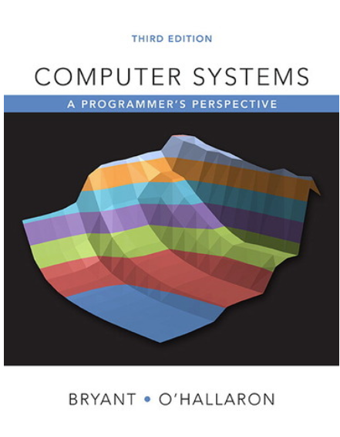
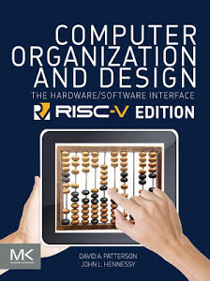
Textbooks
The C Programming Language 2nd ed,
Kernighan and Ritchie
Computer Systems -- A programmer's perspective, 3rd ed, Bryant and O’Hallaron.
Computer organization and design (RISC-V edition), Patterson and Hennessy

Slide 27
Grade Breakdown
5 programming labs
Lab-1,2,3,5: 8%
Lab-4: 10%
Weekly assessments (take-home)
14 total, starting next week
1.5% each
Midterm (80 minutes)
- 14%
Final exam (80 minutes)
20%
Participation: 3%
Includes participation in lecture, recitation, online forum (Campuswire)

Slide 28
5 individual programming labs
Programming environment:
Use Courant’s compute server (snappy1)
Learn to use:
a text editor to write code
git for version control
Optional bonus exercises.
Submission:
Push to github
Submit and have it graded via Gradescope
Late policy:
6 (cumulative) grace days in total over the semester.
3 max. grace days for each lab.

Slide 29
Weekly assessment (mini-quiz)
Start next week
Done via Gradescope:
Multiple choice questions and short answers
Mostly on the current week’s materials
Open-book individual assessments
Do not consult your classmates or anyone else.
Quiz duration:
24-hours.
Thu 9pm to Fri 9pm (EST). No late submission.
Answers discussed in the following week’s recitation

Slide 30
To thrive in CSO, you should …
Before lecture:
Read assigned book chapters
During lecture/recitation:
Ask questions
Don’t be shy to ask me to repeat.
Labs and weekly assessment.
Start early
Getting help:
Campuswire
Office hours (see post on Campuswire)

Slide 31
Integrity and Collaboration Policy
Carnegie Mellon
The work that you turn in must be yours
You must acknowledge your influences
E.g., if you are inspired by a code snippet, include the URL to the snippet in the lab you turn in.
You must not look at, or use, solutions from prior years or the Web, or seek assistance from the Internet
You must take reasonable steps to protect your work
You must not publish your solutions
We reserve the right to randomly pick students for oral assessment and over-weight oral assessment if it does not match your quiz/lab performance.

Slide 32
Integrity and Collaboration Policy
Carnegie Mellon
We will enforce integrity policy strictly and report violators to the department and Dean.
Do not turn in labs/quiz that are not yours
You won’t fail because of one missing lab/quiz

